Slide 1
The Library
Service Area Program Review
Prepared by Darci L. Adolf
31 Jul 2019

Slide 2
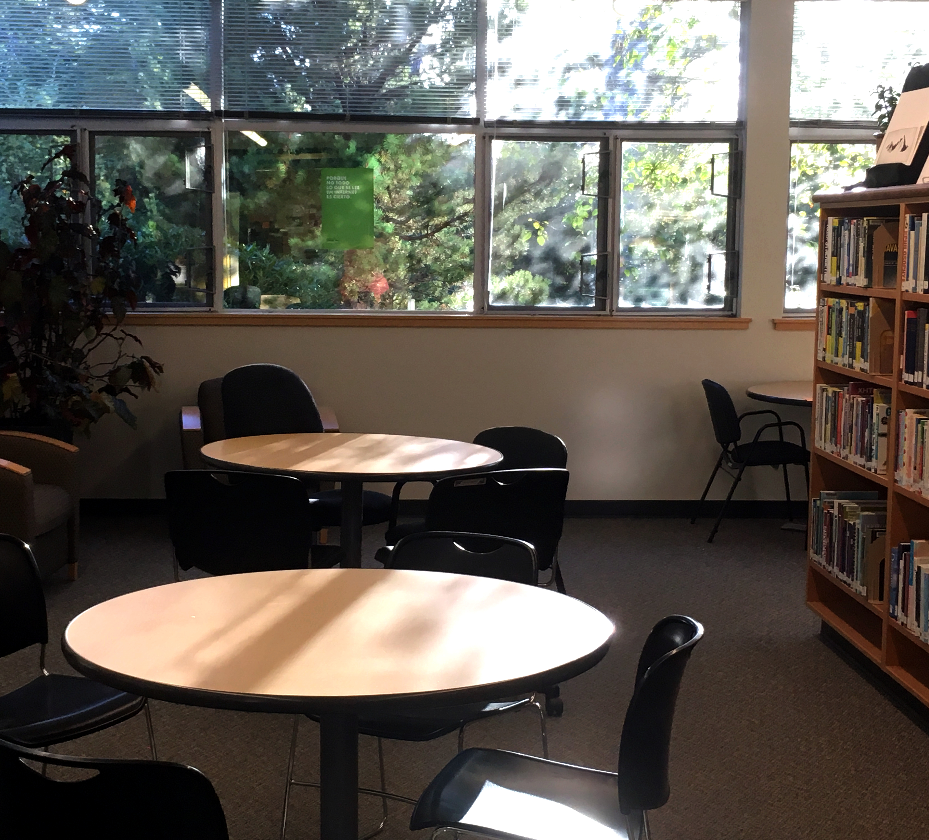
Library Functions
Partners with the College to develop and support information-literate learners
Provides access to collections that incorporate resources in a variety of formats in support of the research and teaching missions of the College
Provides welcoming physical and virtual environments conducive to study and research

Slide 3
The Library contributes to the achievement of the College Mission and the Core Theme of Student Success
The Library contributes to the Core Theme of Student Success by helping students to “feel welcomed, included, engaged, and supported”
The Library supports students as they progress/persist toward their educational goals and experience academic success

Slide 4

Library Staffing, a Look Back
1991: The first professional librarian was hired as the OCCC Library & Media Services Director
2000: A second professional librarian position was added as Assistant Librarian
2015: The Library structure underwent a major revision, reducing the number of professional librarians down to one, and adding a classified staff position

Slide 5


Library Staffing, Today
The Library & Information Services Manager is a professional librarian position, providing Information Literacy instruction and administering all aspects of Library collections, services, and spaces in support of academic programs, faculty teaching, and student learning.
The Library Assistant II is classified position and is responsible for User Access and Technical Processing Services, as well as Course Reserves and InterLibrary Loans. You will find Shannon McKibben at the Library Services window assisting faculty, staff, and students.

Slide 6
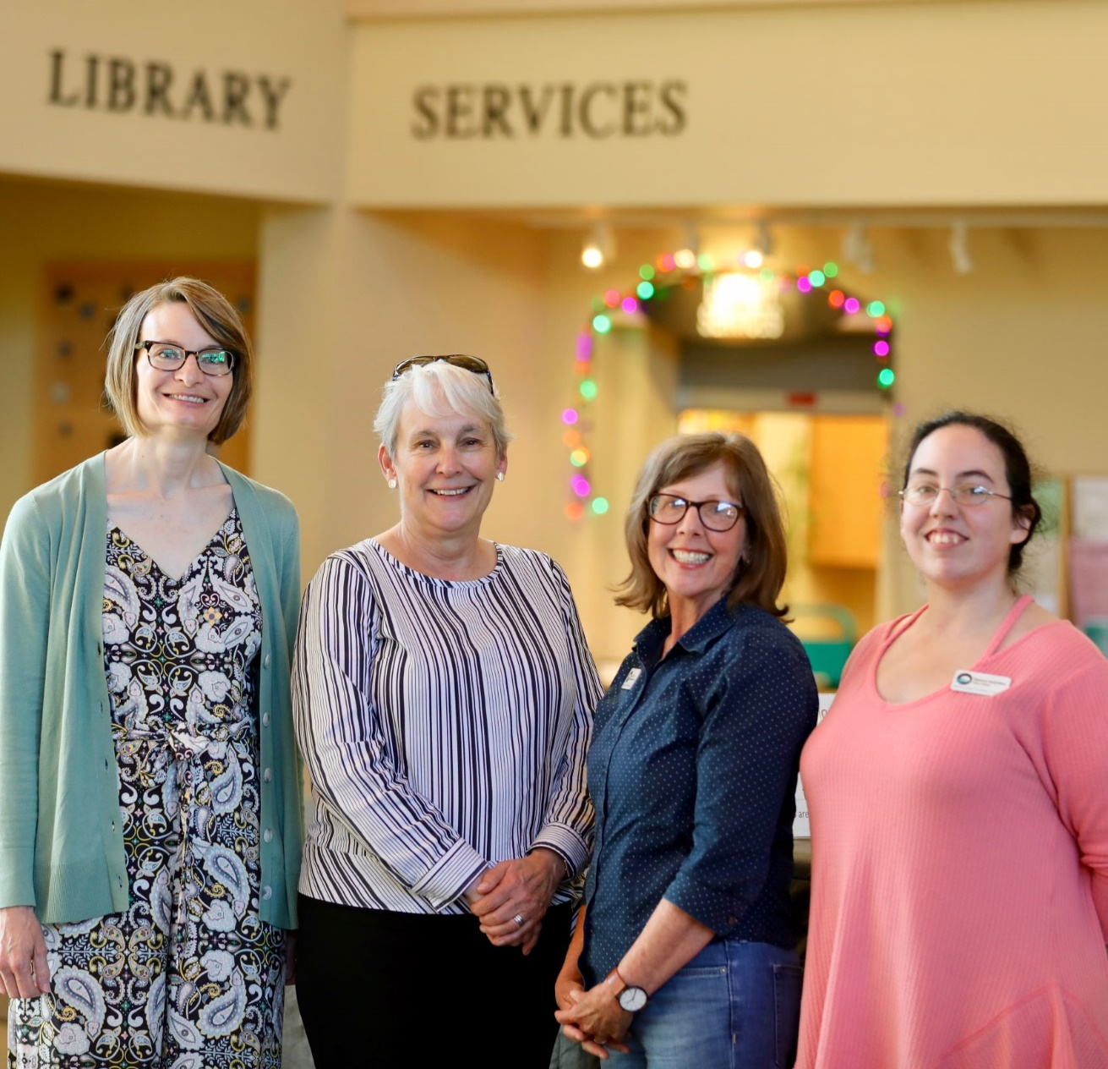
Library Strengths
The biggest strength of the OCCC Library is their relationship with the College campus and the broader community through multiple strategies in order to advocate, collaborate, and educate.

Slide 7
Library Weaknesses
Lack of a digital repository serving both the institution and the community at large
Ability to provide new and innovating technologies to students in a larger way

Slide 8
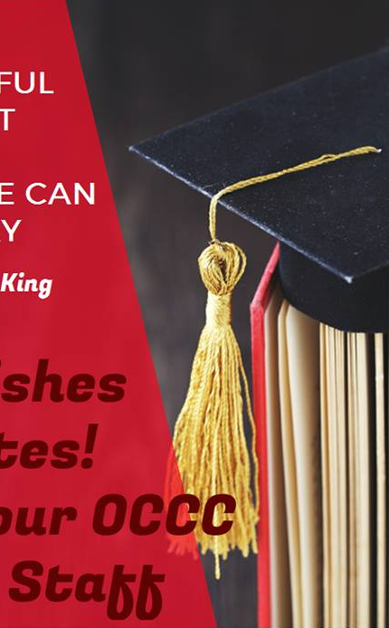
1. Institutional Effectiveness: Libraries define, develop, and measure outcomes that contribute to institutional effectiveness and apply findings for purposes of continuous improvement
The Library develops outcomes that are aligned with accreditation guidelines for the institution.
Outcome: The Library performance outcomes align with the NWCCU Accreditation Standards for the library. The Library standards are based on the ACRL Standards for Libraries in Higher Education which were created using regional accreditation standards for libraries.

Slide 9
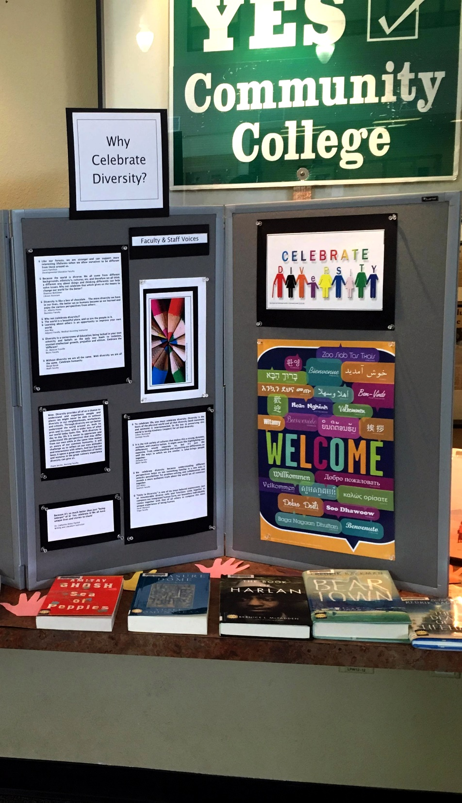
2. Professional Values: Libraries advance professional values of intellectual freedom, intellectual property rights and values, user privacy and confidentiality, collaboration, and user-centered service.
The Library engages in collaborations both on campus and across institutional boundaries.
Outcome: Various segments of the college community partner with the Library to plan events or provided resources. The Library routinely partners with others in events and displays. For example during Mental Health week, the Library provided a display in addition to working with students and faculty to provide information at the front desk.

Slide 10
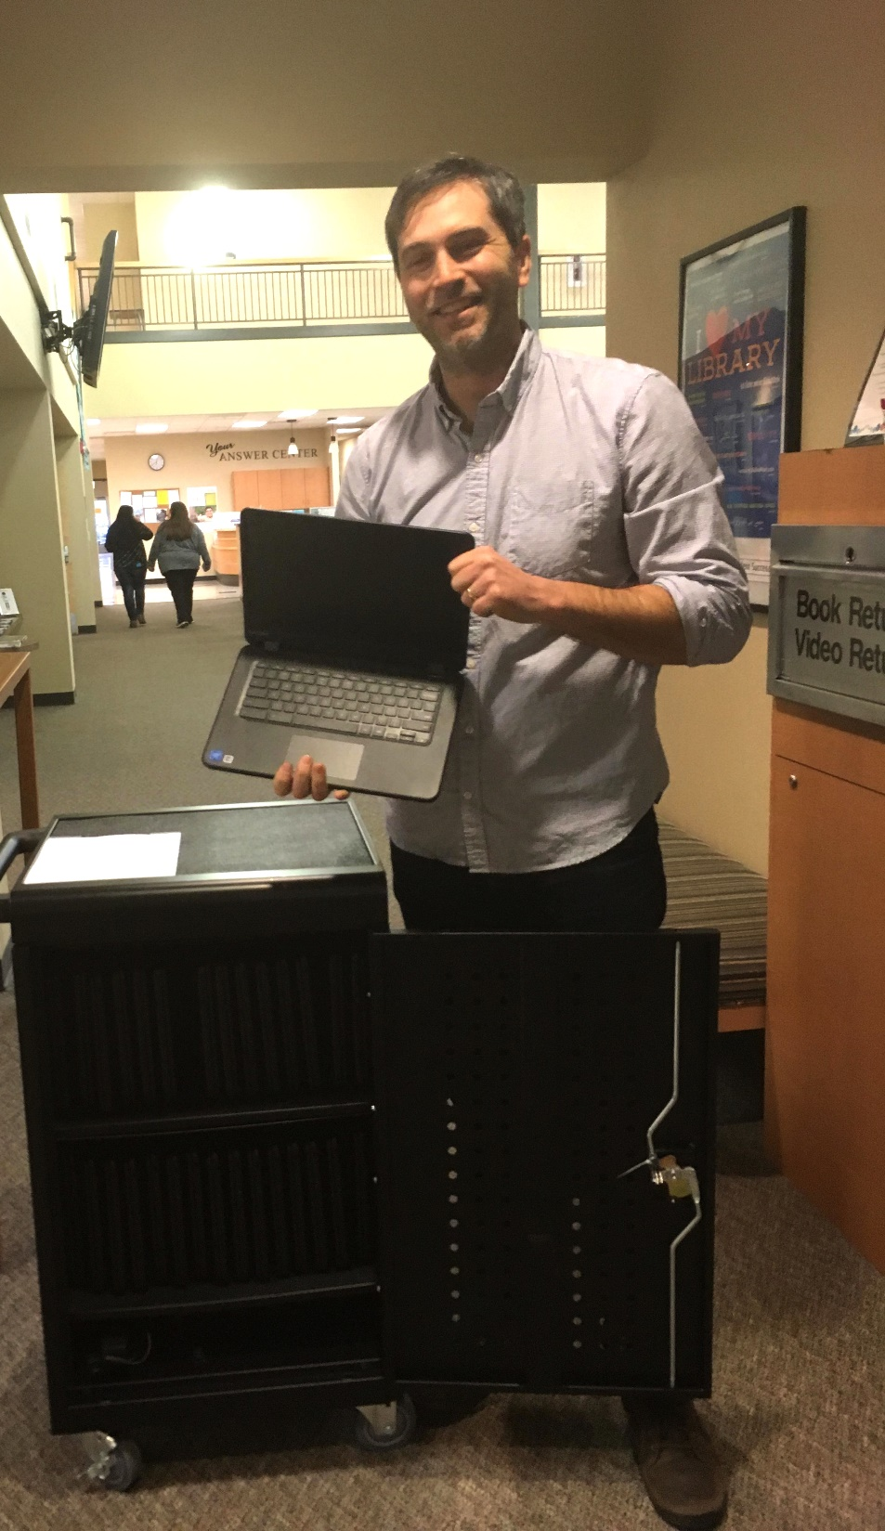
3. Educational Role: Libraries partner in the educational mission of the institution to develop and support information-literate learners who can discover, access, and use information effectively for academic success, research, and lifelong learning.
Students are able to discover, access, and use information effectively for academic endeavors.
Outcome: Increasing numbers of students are able to search the databases and retrieve full-text documents to support their research projects each academic year. According to the 2018 ACRL Survey, 10,835 full-text articles were downloaded from the OCCC Library databases.

Slide 11
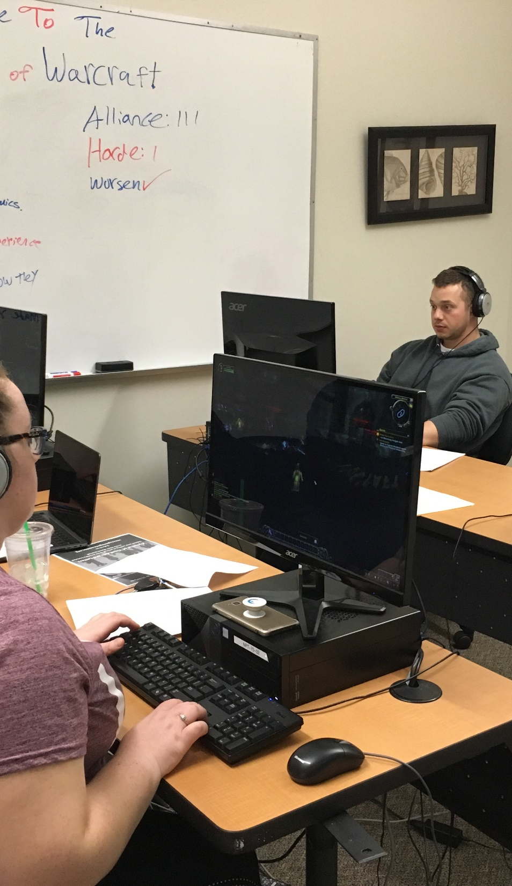
4. Discovery: Libraries enable users to discover information in all formats through effective use of technology and organization of knowledge.
The library integrates library resources access into institutional web and other information portals.
Outcome: Students are able to access Library resources from the website and the LMS. Working with the Web Dev team, the Library has completely remodeled their website, moving the majority of the databases and electronic resources to the LMS. On the most recent student survey, students were asked, “Have you found it easy to access Library resources?” Over 83% responded that it was easy or very easy to access Library resources.

Slide 12
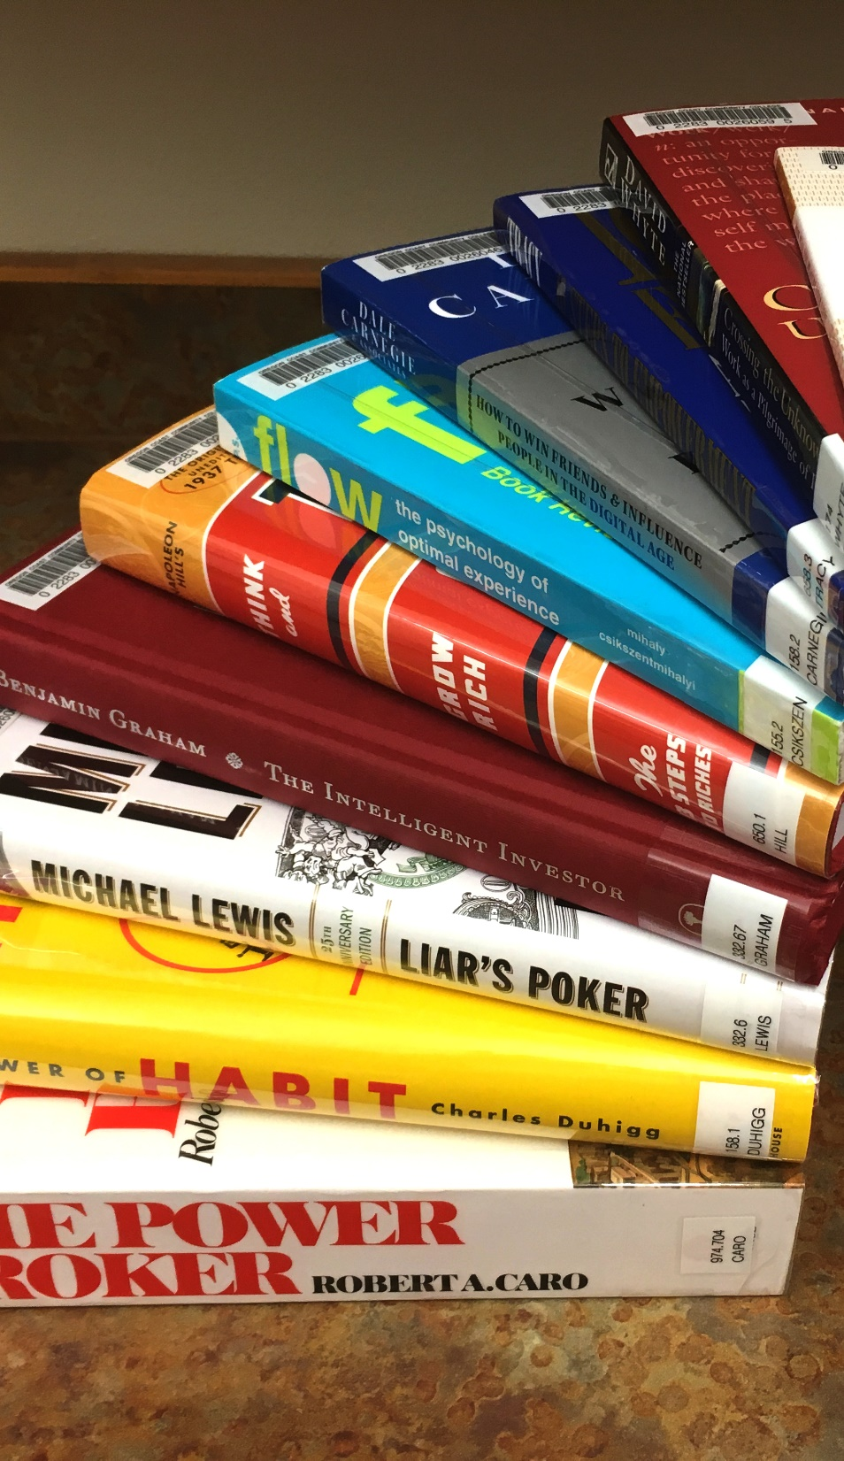
5. Collections: Libraries provide access to collections sufficient in quality, depth, diversity, format, and currency to support the research and teaching missions of the institution.
The Library provides access to collections aligned with areas of research, curricular foci, or institutional strengths.
Outcome: Collection development includes faculty input to provide resources that support teaching and learning each quarter. Faculty are contacted by the Librarian quarterly to solicit collection development suggestions, course reserves, and textbooks on reserve.

Slide 13
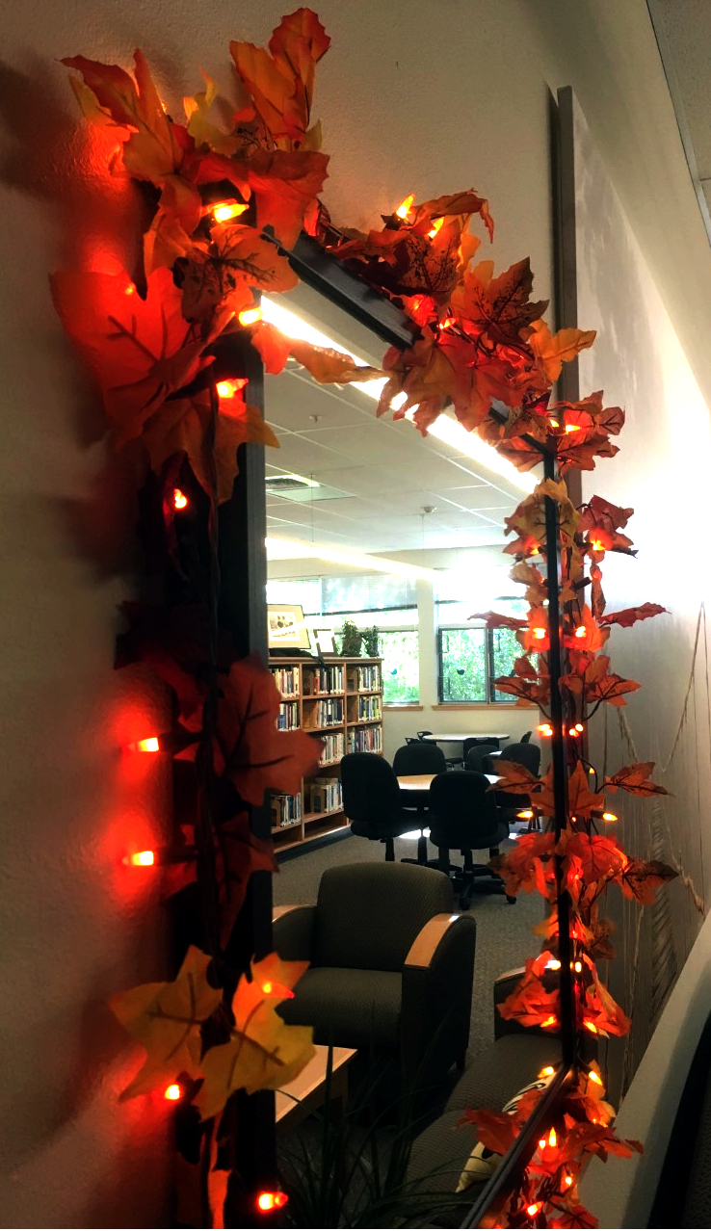
6. Space: Libraries are the intellectual commons where users interact with ideas in both physical and virtual environments to expand learning and facilitate the creation of new knowledge.
The Library provides safe and secure physical and virtual environments conducive to study and research.
Outcome: The Library gate counter indicated that there were 9341 uses of the main Library and Team Lab and 1250 uses of the Study Rooms between Summer 2017 and Spring 2018. Benchmarked.

Slide 14
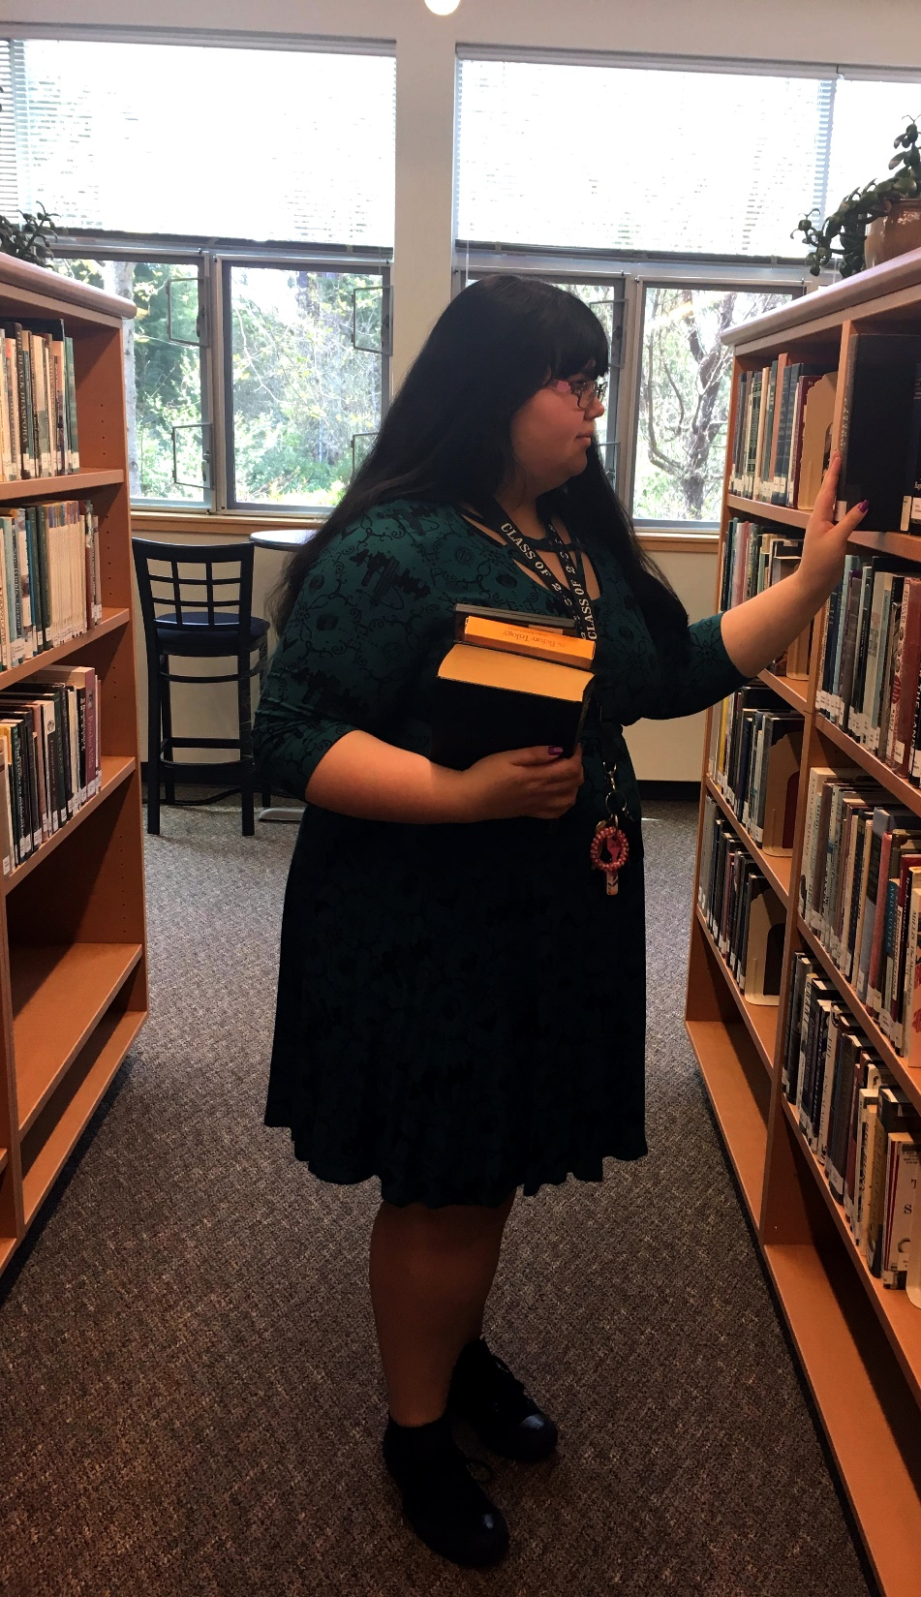
7. Management/Administration/Leadership: Library leaders engage in internal and campus decision-making to inform resource allocation to meet the library’s mission effectively and efficiently.
The Library partners with multiple institutions to increase cost-effectiveness and to expand access to collections.
Outcome: The Librarian collaborates with outside partners to expand resources and minimize costs. For example, the Library is a member of the Chinook Libraries Network– we save money and increase resource volume at the same time.

Slide 15
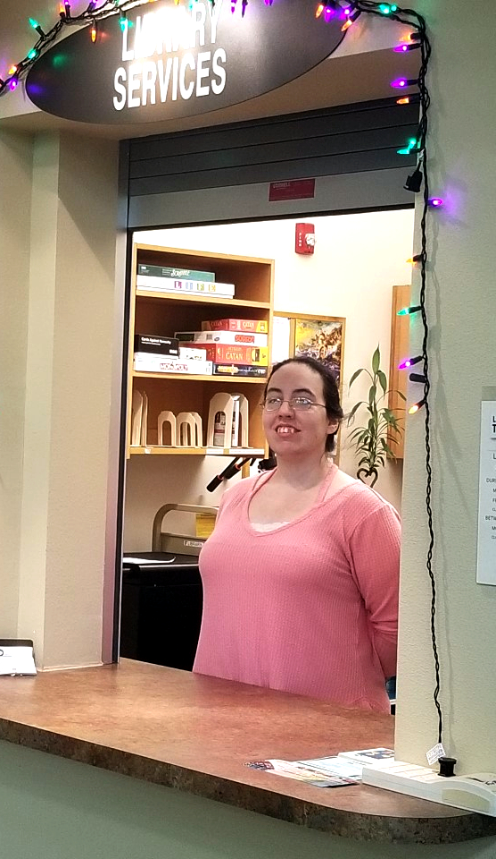
8. Personnel: Libraries provide sufficient number and quality of personnel to ensure excellence and to function successfully in an environment of continuous change.
Library personnel are sufficient in quantity to meet the diverse teaching and research needs of faculty and students.
Outcome: Students were polled in the Spring Survey with this question: “Do you feel that the Library has enough staff to meet your needs in a timely manner?” 34% said always, 58% said usually, and 7% said sometimes. A follow-up study is needed.

Slide 16
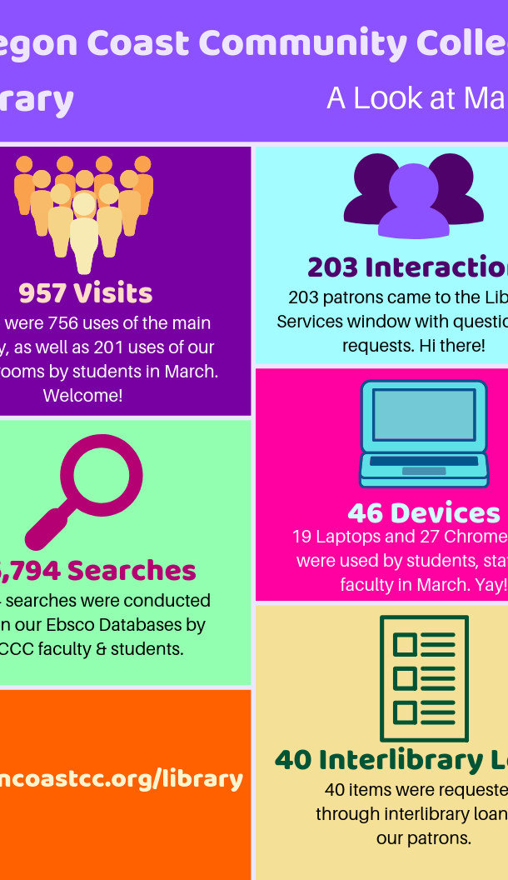
9. External Relations: Libraries engage the campus and broader community through multiple strategies in order to advocate, educate, and promote their value.
Library personnel convey a consistent message about the Library to expand user awareness of resources, services, and expertise.
Outcome: Library planning includes communication planning to target various audiences, messaging, methods, and continuous-improvement assessment. User awareness is central to our messaging planning and the Library looks to technology and social media to reach users where they are.

Slide 17
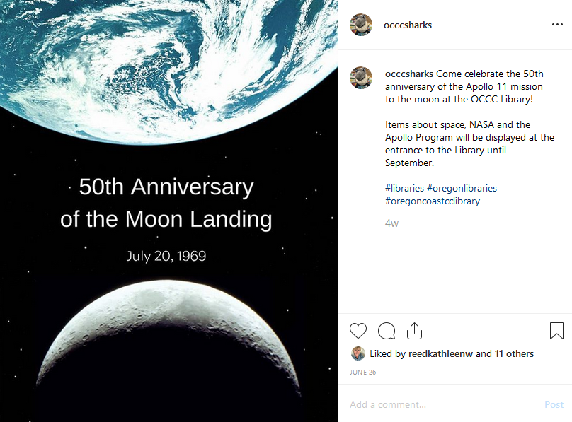

Slide 18
Identification of Future or Unmet Needs
Goal
Goal #1: The College Repository
Goal
Goal #2: Acquire New Technologies for Student Learning
Goal
Goal #3: Replacement of Decades-Old Furniture

Slide 19

In Conclusion
ACRL defines outcomes as “the ways in which library users are changed as a result of their contact with the library’s resources and programs.” Outcomes are user-centered, and thus they are not wholly under the library’s control. Nonetheless, the outcome or impact of the library’s actions is ultimately how we must judge our success. Outcomes, assessment, and evidence all are elements of the continuous improvement cycle.
This program review provides us with an opportunity to share a bit of our standards and outcomes with you. Thank you!
The complete written report can be found: https://www.oregoncoastcc.org/library/

Slide 20
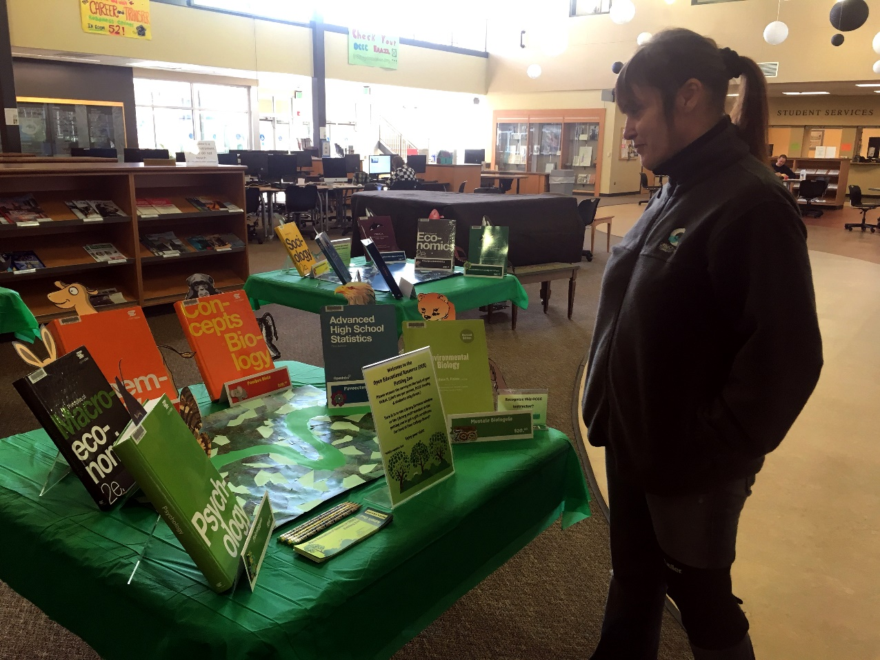
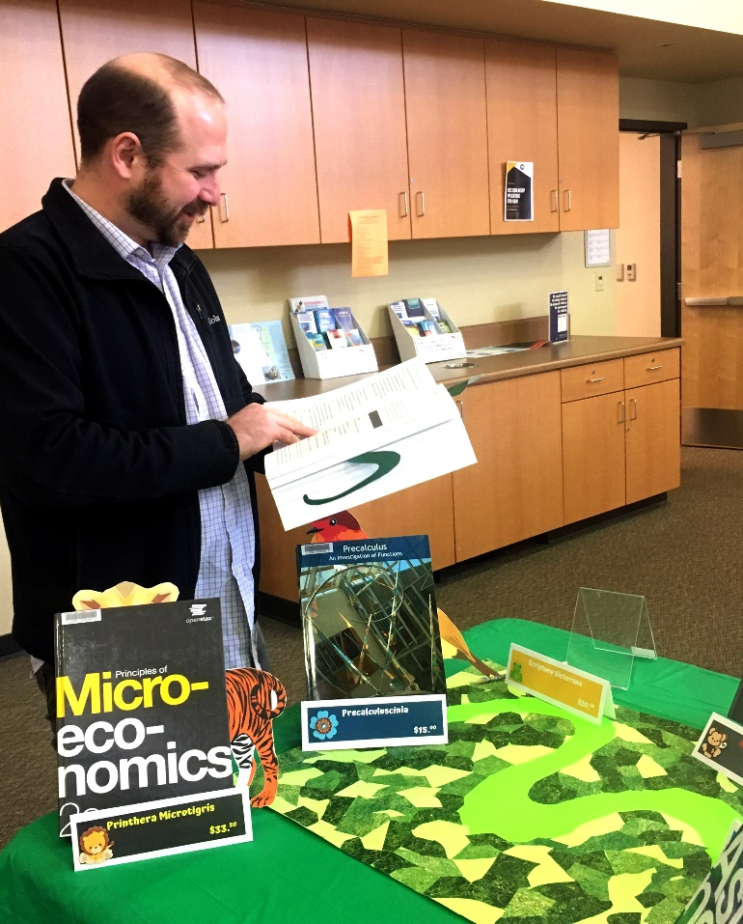

Slide 21


Slide 22
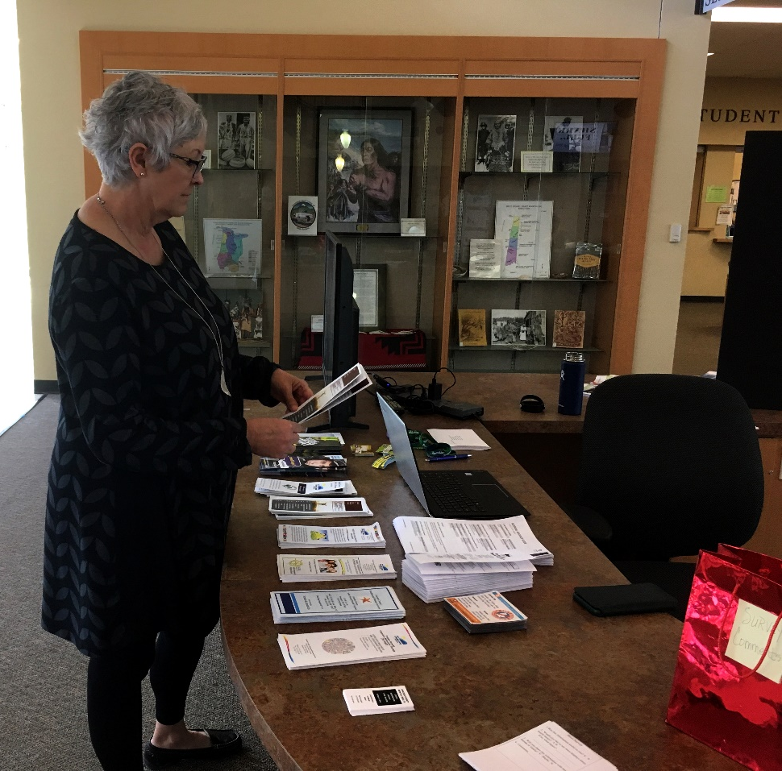
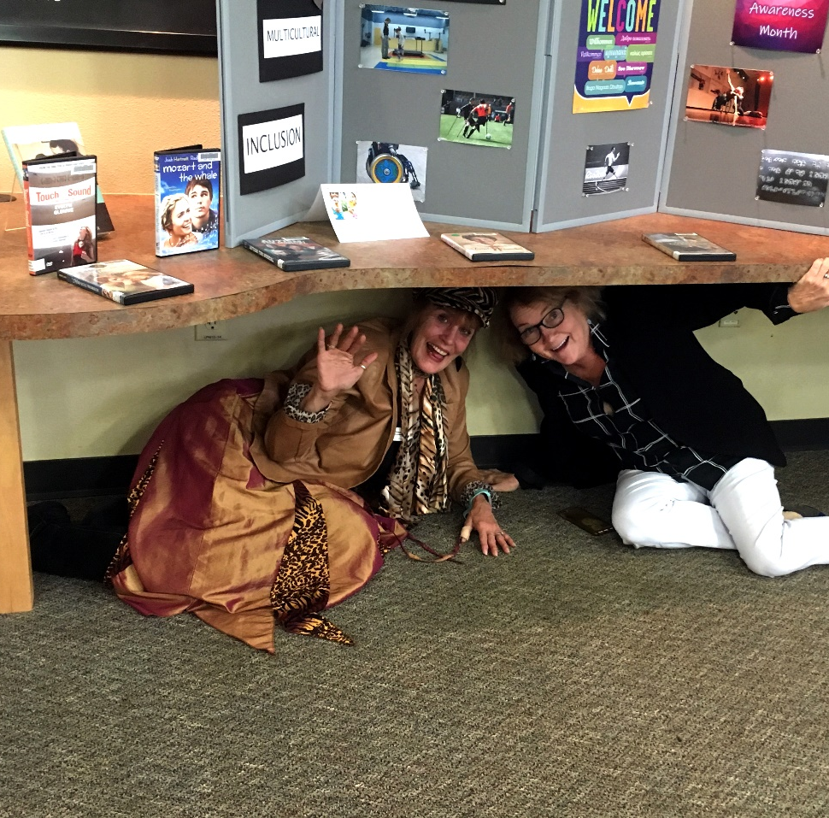

Slide 23
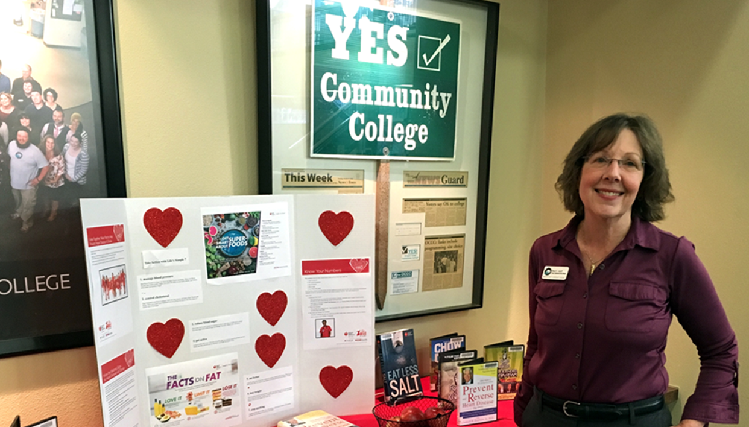
The End!!!

