Slide 1

Welcome to Oregon Coast Community College
Academic Orientation
2019-2020

Slide 2
In this orientation:
What you need to know about student success at OCCC
Getting Organized
Tutoring
Important dates and policies
How to make the most of Academic and Career Advising
Programs and transfer resources
Satisfactory Academic Progress
How to register for classes
Electronic Tools and Communication
Preparing for your appointment
Financial Aid overview

Slide 3
At the end of the orientation…
You’ll know:
How to register for classes
Important dates for your first term
Where to look for resources
Tips for being a successful student

Slide 4
Welcome to OCCC
Placeholder for video of President and Dean of Students

Slide 5
Think about it
What are some of the reasons that brought you to college?
What strengths do you bring with you?
What will help you to succeed at OCCC?

Slide 6

Reception line
Name
Major / degree if you have selected one (optional)
What are some of the reasons that brought you to college?
What strengths do you bring with you?
What will help you to succeed at OCCC?

Slide 7
Student Success
What YOU need to know

Slide 8
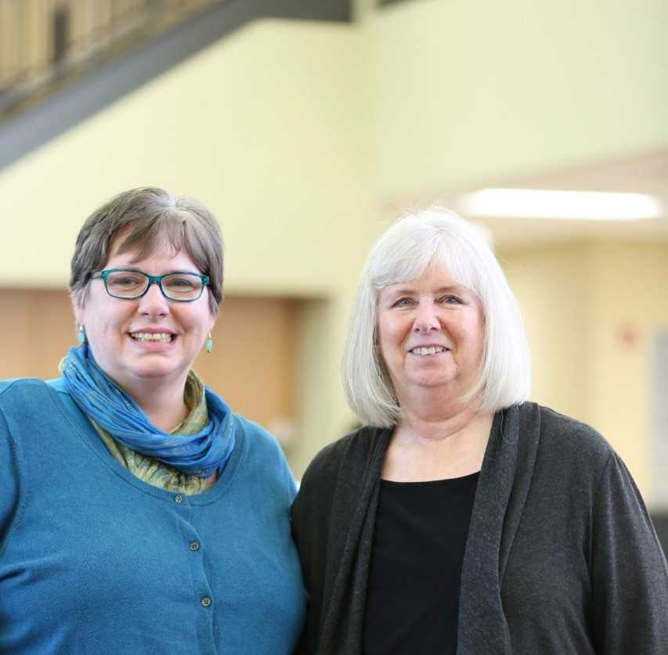
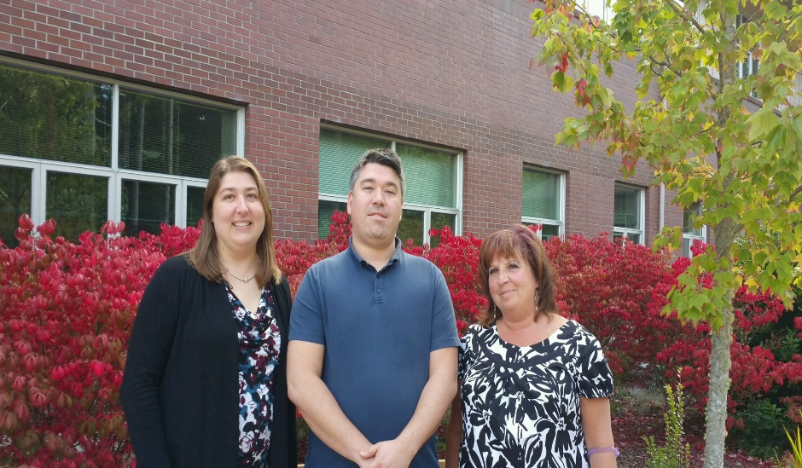
Theresa Harper
Early Childhood
Pre-Education
Blake Hagan
Aquarium Science
Accounting &
Administrative Programs
Colleen Doherty
Nursing &
Allied Health Programs
Kimberly Jones, Enrollment Services Manager
Cindy Carlson, Dean of Students

Slide 9
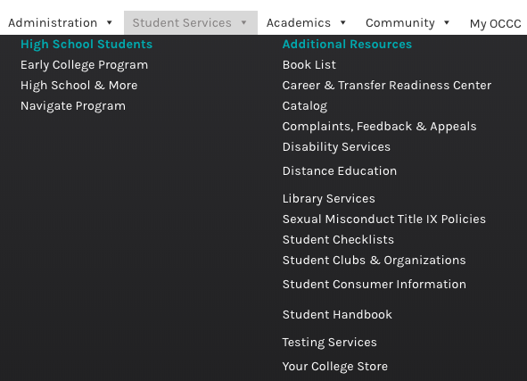
OCCC Website - resources
At the top of the website, select the
‘Student Services’ menu for easy links
to a variety of resources, such as:
Advising
Course Schedules
Library Information and databases
Complaints, Feedback and Appeals
Student Rights and Policies
Student E-mail Instructions (Advisor Resources)
http://www.oregoncoastcc.org/student-email-setup-and-access/

Slide 10
Do you know? If not yet, you will…
As a full time student, how many hours per week should you budget to attend class, study, and complete assignments?
What is the difference between dropping and withdrawing from a college course?

Slide 11
Will College be different than what you’re used to?
College is Voluntary and Costly: Tuition & Fees, Books, etc.
Time Management: Rather than having a schedule structured by others you manage your own time.
Self Motivation: Instructors often times will not remind you of deadlines they expect you to know them after the first day of class per the syllabus.
Note Taking: Take advantage of in class time lectures, this information may not be necessarily given to you after class.
Textbooks: Many of your courses will require you to purchase textbooks, which can be expensive. Plan on having your books before the first class.
Attendance: May or may not be graded. First week attendance is mandatory.

Slide 12

How much time do you have? How much will you need for classes?
In general:
For every credit you are registered for you can expect to spend one hour per week in class (or online) and 2-3 additional hours out of class studying.
Being a full-time student is a similar time commitment to a full-time job.

Slide 13
Calendars, planners, Time management tools
Print Tools:
  http://success.oregonstate.edu/learning/all-worksheets
  Daily Planners
  Weekly Planners
  Term Planners
    Include all tests and assignments
    Color code
Print Your Own:
  https://www.themakeyourownzone.com/2017/08/2018-free-printable-planner-pages.html
Electronic Tools:
  Phone calendars
  Calendar Apps http://lifehacker.com/5048189/five-best-calendar-applications
    Google
    Other
      http://web.appstorm.net/roundups/15-cool-alternatives-to-google-calendar/
      https://www.thebalance.com/free-online-calendars-1357935
    Smartphone Apps:
      http://www.businessinsider.com/the-12-best-apps-for-students-studying-productivity-and-homework-2016-8​

Slide 14
Placeholder for student voices

Slide 15
You’re not in this alone
Share your goals and why going to college is important, with others. Your schedule may be changing
  Employers – how many hours can you work, and will you be available on-call?
  Family / friends – how can they support you in balancing your old and new commitments?

Slide 16
You’re not in this alone
OCCC has FREE resources to help with your academics:
  Math Lab
  Writing Lab
  Tutoring
  Library Rooms/Computer Labs
  Office 365
  Forgot Your Lunch?

Slide 17
Student Involvment
Get involved with your classmates!
  Attend a campus event –Shark Bites, Welcome Week, Student Forums, etc.
  Associated Student Government
  PTK Honors Society
  Clubs – Costuming, Drama,Eco-green, Equity and Inclusion, Gaming, Gender Sexuality Alliance, Journalism, Sea Fans, STEM, Student Nurses, Waves
  Start a new club!
  http://www.oregoncoastcc.org/campus-life/

Slide 18


Electronic tools and communication
Your MY OCCC Portal
  CANVAS
  Registration
  College Email – OCCC
http://oregoncoastcc.org/myoccc/

Slide 19
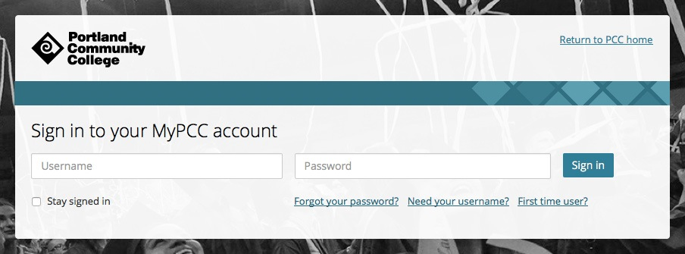
Electronic tools and communication
My PCC:
  Financial Aid
  Transcript Evaluations
  Grad Plan
  https://my.pcc.edu

Slide 20
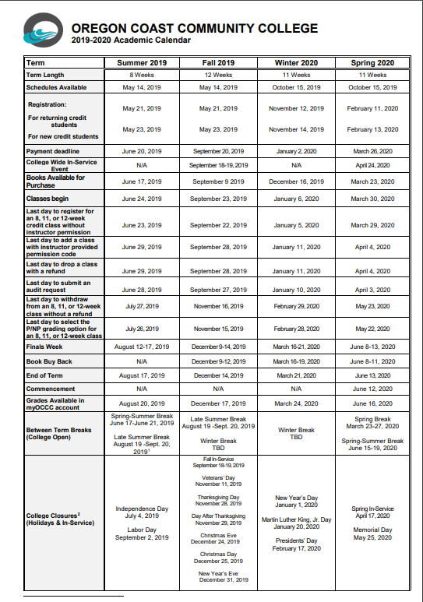
Important dates
Academic Calendar available in the “Quick Links” section
For next term when is your:
Payment deadline
First day of class
Last day to add/drop classes
Last day to withdraw from classes
Finals week

Slide 21
Drops and withdrawals
What’s the difference?
 | Drop | Withdrawal
Dates possible | Week 1 | Weeks 2-8
Tuition refund | Yes | No
On Transcript | No | Yes – “W” grade
Affects GPA | No | No
Can affect financial aid | Yes | Yes
Discuss with an advisor first | Yes | Yes

Slide 22
Check your Knowledge
As a full time student, how many hours per week should you budget to attend class, study, and complete assignments?
What is the difference between dropping and withdrawing from a college course?

Slide 23
Academic and career advising
How to make the most of your appointments and resources

Slide 24
Do you know? If not yet, you will…
Why is it important to know language requirements for a University?
Why is a growth mindset important to develop as a student?

Slide 25

Growth Mindset
Research by Carol Dweck and others suggests that mindset is just as important as ‘talent’ in determining success
Image: Fabio Sinibaldi
https://medium.com/@fabiosinibaldi/the-two-mindsets-that-determine-our-destinies-a3f87e6c7da7

Slide 26
Career exploration
Advising appointments
Your short and long term Goals
Consider all your strengths and interests
Oregon Career Information Systen
Online Career and College Exploration tool
Personal assessments
Bureau of Labor Statistics
Nationwide job outlooks
Search by pay or industry growth
Information about occupations
Research degrees and scholarships
Free for all students
Visit the CTRC

Slide 27
Program planning
Selecting a degree or certificate program
http://oregoncoastcc.org/degrees/
http://oregoncoastcc.org/certificates/
Course selection
Watch for Prerequisites
Plan to start sequence classes in the fall (Examples: Biology, Spanish)
Math pathway appropriate for goals
Plan on CG 100 in your first or second term
Know if you need a foreign language

Slide 28
Tracking your progress
  Grades are important: C or better requirement
  Instructors and advisors work together to communicate with and offer resources to students whose academic success is at risk through Early Alerts

Slide 29
Academic integrity and plagiarism
Plagiarism:
Collusion (Inappropriate Assistance)
Cheating
Presenting someone else’s words, ideas, artistry, product, or data as one’s own.
Helping another commit an act of academic dishonesty.
Knowing or negligently allowing your work to be used by others.
Create and offer to sell all or part of an educational assignment.
Act of deceit, fraud, distortion of truth, or improper use of another person’s effort to obtain and educational advantage.
Includes, but is not limited to, unauthorized access to examination materials prior to the exam.
https://catalog.oregoncoastcc.org/academic-integrity

Slide 30
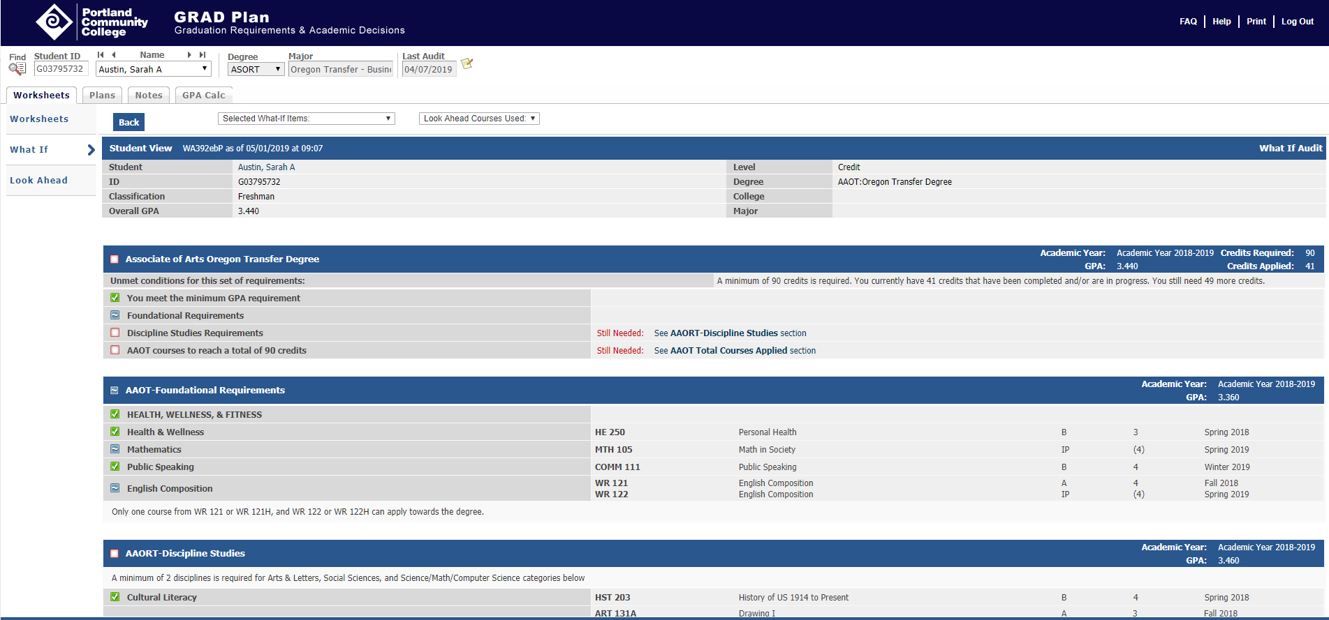
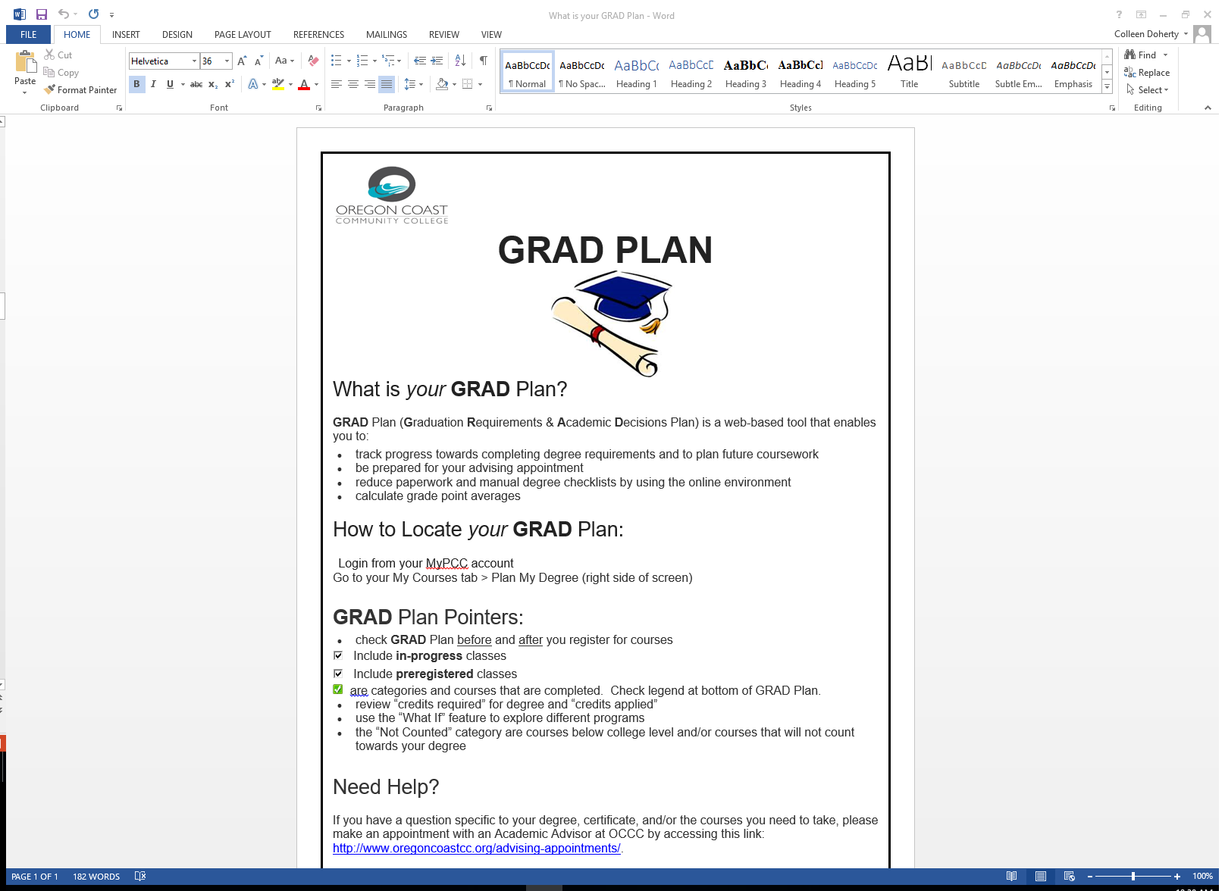
Tracking your progress: the mypcc grad plan

Slide 31
Make the most of your advising appointments
Advising is required every term
  Schedule an appointment online at or before week 6 of the term
  Review your GRAD Plan
  Prepare your schedule ideas for the next term and your academic plan
  Ask for resources in any area you would like to be performing better
  Write down questions so you don’t forget to ask!

Slide 32
Check your knowledge
Why is it important to know language requirements for a University?
Why is a growth mindset important to develop as a student?

Slide 33
Paying for school
Financial Aid overview and student account policies at OCCC

Slide 34
Do you know? If not yet, you will…
What is required to stay in Good Academic and Financial Standing?
Who would you contact with questions about financial aid?

Slide 35
SATISFACTORY ACADEMIC PROGRESS and ACADMEMIC STANDARDS http://www.oregoncoastcc.org/sap/
SAP (Financial Aid Recipients) https://www.pcc.edu/enroll/paying-for-college/financial-aid/maintain-eligibility/satisfactory-academic-progress.html
Maintaining a cumulative grade point average of a 2.0 or higher
Successful completion of two-thirds of attempted credits each term
Ability to complete declared degree or certificate within 150% maximum timeframe limit
Financial Aid Good Standing
Financial Aid Warning
Financial Aid Suspension - Must do appeal with Advisor
Financial Aid Probation - Must be in good standing for 1 term and follow plan.
ACADEMIC STANDING (Everyone) https://www.pcc.edu/resources/student-records/academic-progress/academic-standards.html
Maintaining a cumulative grade point average of a 2.0 or higher
Successful completion of two-thirds of attempted credits each term
Academic Warning
Academic Probation
Academic Suspension - Must do appeal/re-entry form with Advisor

Slide 36
What is financial aid?
    Grants
  Eligibility based on financial need
  No repayment required
    Loans
  Must be paid back with interest
  Interest is a fee charged for borrowing money
    Scholarships
  Based on GPA, financial need, achievements, or a combination
  No repayment required

Slide 37
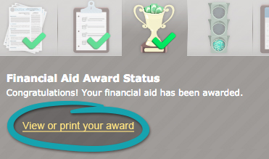
Is my financial aid ready?
Check the status is your myPCC account.
Your financial aid is ready if you have satisfied all of your financial aid requirements, and have a financial aid offer that you have accepted the terms and conditions of.

Slide 38
What if I have an award letter that I have accepted in my myPCC account?
Your financial aid offer letter is based on a 12 or more credits. Your offer will be adjusted based on the number of credits you register for.
Anytime you change your schedule by adding or dropping a class, your total of tuition and fees may change!
To be eligible to receive student loans, student must be enrolled in 6 or more credits.
After you register today your total credits, tuition, and fees will be on your class schedule.

Slide 39
If I’m expecting a refund, how will I get it and when?
Award Status | Type of Aid | When I will receive the refund
Accepted award letter and no financial aid requirements before the start of the term. | Grant | Approximately the 3rd week of the term.
Accepted award letter and no financial aid requirements before the start of the term. | Loan | Student who has borrowed student loans before - Approximately the 3rd week of the term. First time loan borrower – loan money will be held for 30 days from the start of the term.

Slide 40
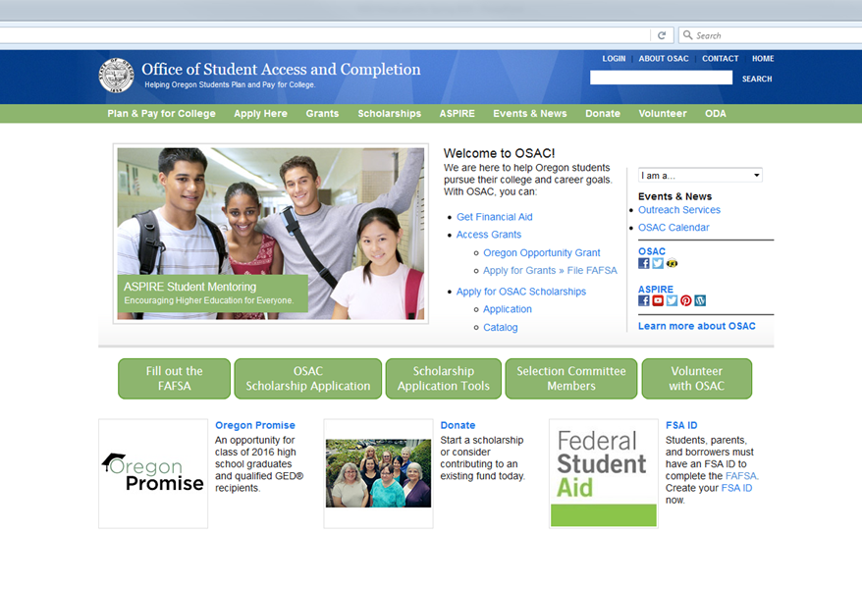
What about scholarships?
oregoncoastcc.org
oregonstudentaid.gov
oregoncis.uoregon.edu
OCCC homepage, Quick links (bottom Right of page) http://www.oregoncoastcc.org/QUICK LINKS
Scholarships

Slide 41
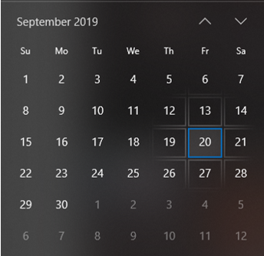
Payment deadlines
In general, the payment deadline occurs in the week before classes start each term.
For Fall this is September 20, 2019
By the payment deadline you must do one of the following:
Have a financial aid offer accepted that covers the full amount of tuition
Pay your tuition bill in full
Have an approved payment plan on file and have made your first payment
Students who have not paid or put a plan in place by the payment deadline will be dropped from their classes.

Slide 42
Check your knowledge
What is required to stay in Good Academic and Financial Standing?
Who would you contact with questions about financial aid?

Slide 43
Registering for classes
Step-by-Step guide

Slide 44
Contact Information for resetting password and permission codes for courses:
Please call Student Services (Newport) 541-867-8501
or
Student Services (Lincoln City) 541-996-6222
Student Services can reset your MyOCCC password. Please provide photo ID or be prepared to correctly answer three questions to verify your identity.
Please contact your instructor if you need a
4-digit permission code to add a class.

Slide 45
In person
Zoom
Hybrid
Online
Ways to take classes at OCCC

Slide 46
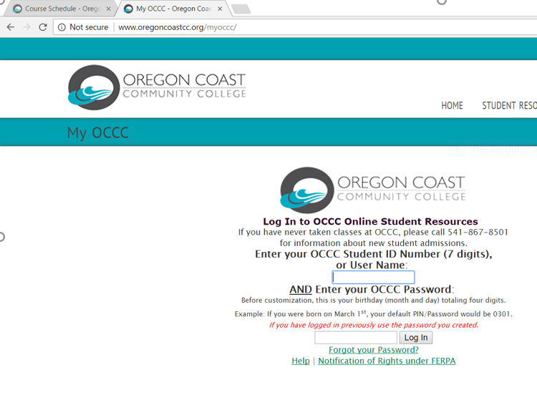

MY OCCC How to register for a class,
OCCC students register online for courses by logging into his/her MyOCCC account. The OCCC Student ID # was on the Admission Letter; the User Name and Password were created by the student when completing the application.
MyOCCC Log In Screen

Slide 47
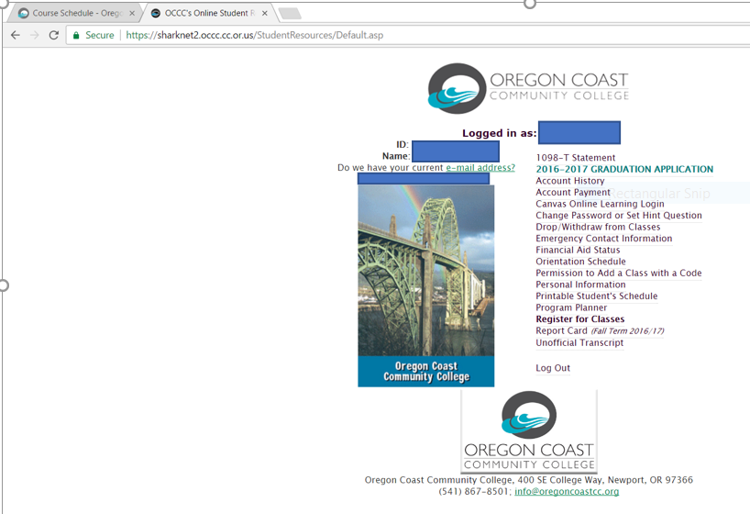
First – How to register for a class
After logging into your myOCCC account, choose the “Register for Classes” option.

Slide 48
How to drop/withdraw from a class
After logging into your myOCCC account, choose the “Drop/Withdraw from Classes” option.

Slide 49
Another option: How to register for a class using a code
Step 1 - After logging into your myOCCC account, choose the “Permission to Add a Class with a Code” option.

Slide 50
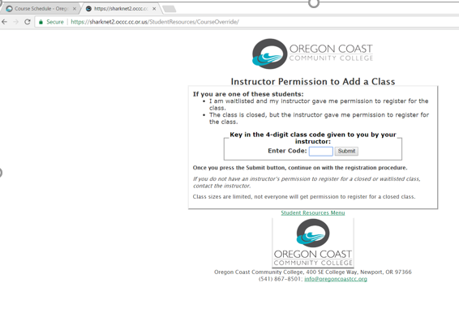
How to register for a class using a code (continued)…
Step 2: Enter the four letter code provided by the instructor
Press the submit button and continue on with the registration

Slide 51
Your next steps:
Register for classes
Communicate your new schedule
Check OCCC email regularly
Check myPCC for missing items if planning to use
financial aid
Order textbooks
Set up transportation, childcare, etc. plans

