Slide 1
Oregon Coast Community College Board of Education Regular Session 6:00 PM Wednesday, October 23, 2019 Central County Center 400 SE College Way Newport, OR 97366

Slide 2
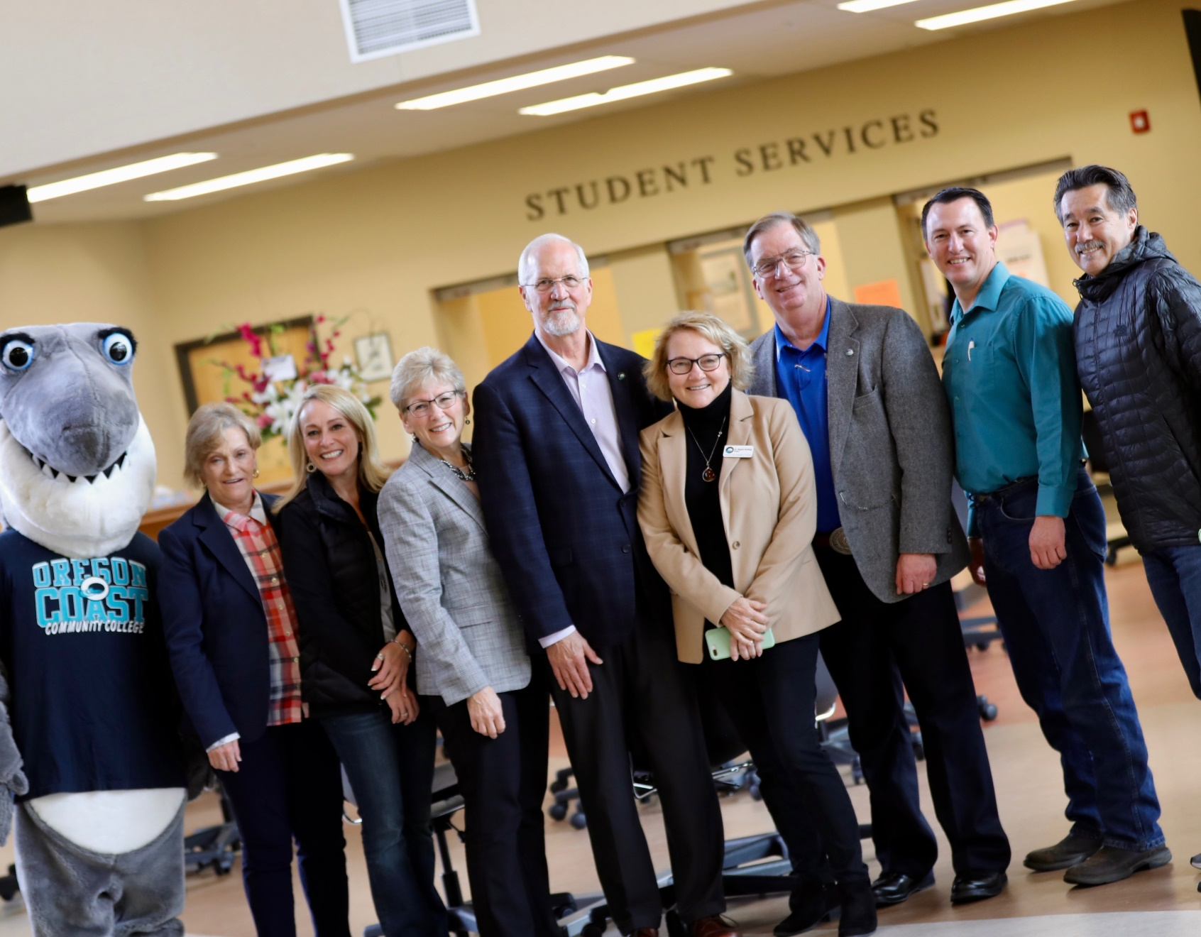
President’s Report

Slide 3
Draft Commendations (paraphrased from Exit Meeting)
Strong community and high school partnerships that advance the core theme of educational pathways.
Staff, faculty and administration create a climate that is cohesive, collaborative and welcoming of students, and maps student experiences through financial advising, multiple measures placement, mandatory advising, and math pathways.
Extensive emergency preparedness and continuity planning, including community partners in the work.
An extraordinary approach to student services.
Maintaining a 12.5% budget reserve and strong healthy fiscal practices.

Slide 4
Draft Recommendations
Assess and fully implement the Performance Evaluation Process (2.B.2, 2.B.3, 2.B.6)
Continue to address Title IV compliance (Cleary Act) to fully be prepared for independence (2.D.2)
Update and produce a Comprehensive Technology Plan (2.G.8)
Integrate the Big 5 Strategic Plan (or its replacement) with Core Theme planning, document and present that planning effort with greater clarity to external observers. Develop purposeful plan for resource allocation and institutional capacity. (3A.1 & 3A.4)
Continue implementation of the Service and Program Area Review (SPAR) process to complete a full five-year cycle. (4.B.1)
Student Learning Outcomes, refine and implement multi-year cycles (4.A.3, 4.B.2)

Slide 5
Recommendation Areas
Candidacy: Spring 2018 | Initial Accreditation: Fall 2019
 | Performance Evaluation Process (2.B.2, 2.B.3, 2.B.6)
 | Continue to address Title IV compliance (Cleary Act) to fully be prepared for independence (2.D.2)
 | Update and produce a Comprehensive Technology Plan (2.G.8)
Fiscal Practices (2.F.1, 2.F.6)
 | Integrate the Big 5 Strategic Plan (or its replacement) with Core Theme planning. Develop purposeful plan for resource allocation and institutional capacity. (3.A.1 & 3.A.4)
Core Theme Planning (3B, 4A, 4B, 5A) | Continue implementation of the Service and Program Area Review (SPAR) process to complete a full five-year cycle. (4.B.1)
Learning Outcomes (4.A.3, 4.A.4, 4.A.5, 5A) | Student Learning Outcomes, refine and implement multi-year cycles (4.A.3, 4.B.2)
Governance & Evaluation (5B.2, 5B.3)
Mission Fulfillment (5.A, 5.B)

